Slide 1

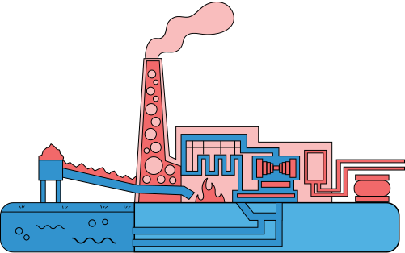

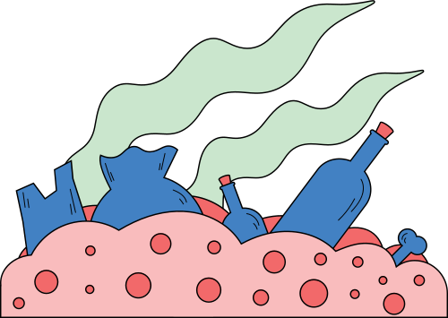
How Solar Energies Produce Power
Batteries , Solar Cells , Biomass

Slide 2
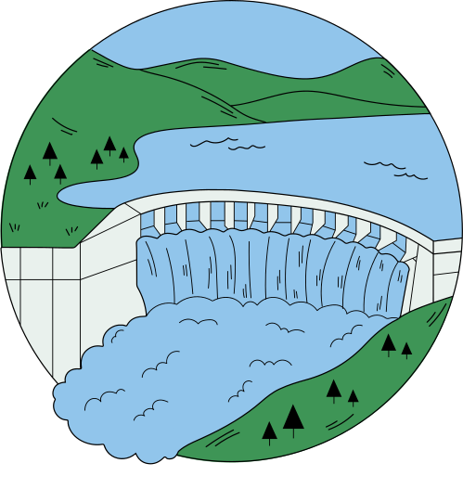

Overview of Energy Sources from the Sun
1. Solar Energy
2. Wind Energy
3. Hydroelectric Energy
4. Biomass Energy
5. Wave and Ocean Energy
6. Fossil Fuels (Indirectly from the Sun)
Almost all major energy sources on Earth can be traced back to the Sun, either directly (like solar power) or indirectly (like wind, water, and biomass). The Sun drives Earth’s climate, weather patterns, and life processes, making it the ultimate source of most of our energy.

Slide 3
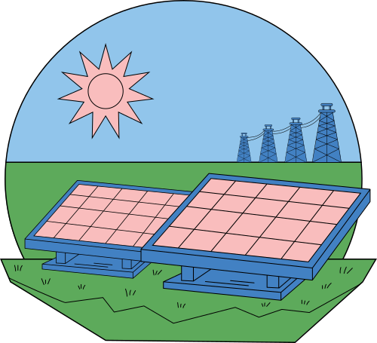
Solar Energy Basics
Solar energy is the light and heat from the Sun that can be used to produce electricity or heat. It is clean, renewable, and does not run out. Solar panels and solar heaters use this energy to power homes, devices, and other everyday needs without causing pollution.

Slide 4
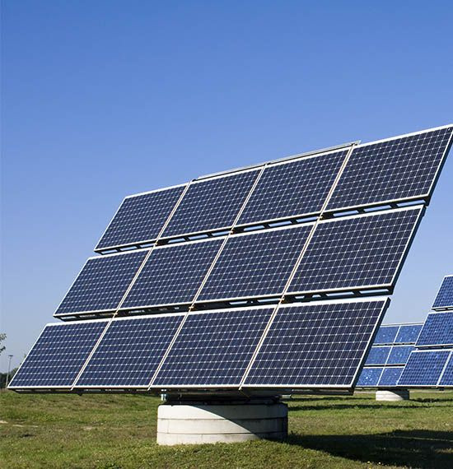
Solar Cells
Solar cells are devices that convert sunlight directly into electricity. They are made of semiconductor materials, usually silicon, that release electrons when exposed to light. When many solar cells are connected together, they form a solar panel that can power homes, gadgets, and other equipment. Solar cells are important because they produce clean, renewable energy without pollution.

Slide 5
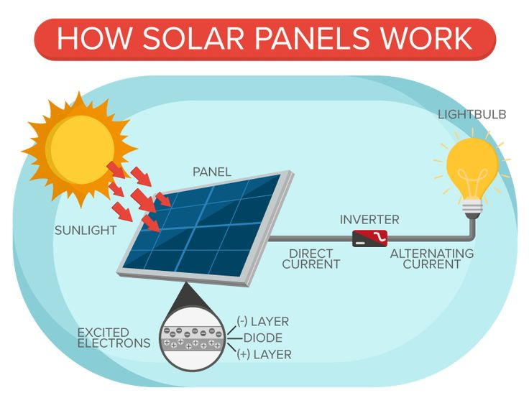
How Solar Cells Work
Solar cells work by converting sunlight directly into electricity. When light hits the semiconductor material inside the cell usually silicon it knocks electrons loose. These moving electrons create an electric current. Metal contacts on the top and bottom of the cell collect this current, which can then be used to power devices or stored in batteries. When many solar cells are joined together, they form a solar panel that produces more electricity.

Slide 6
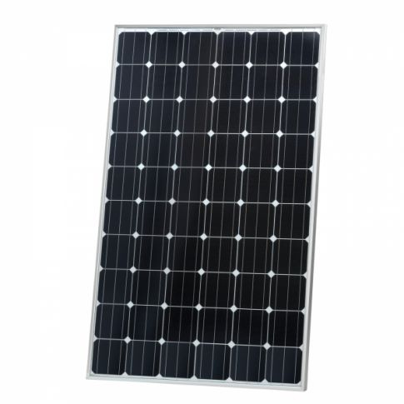
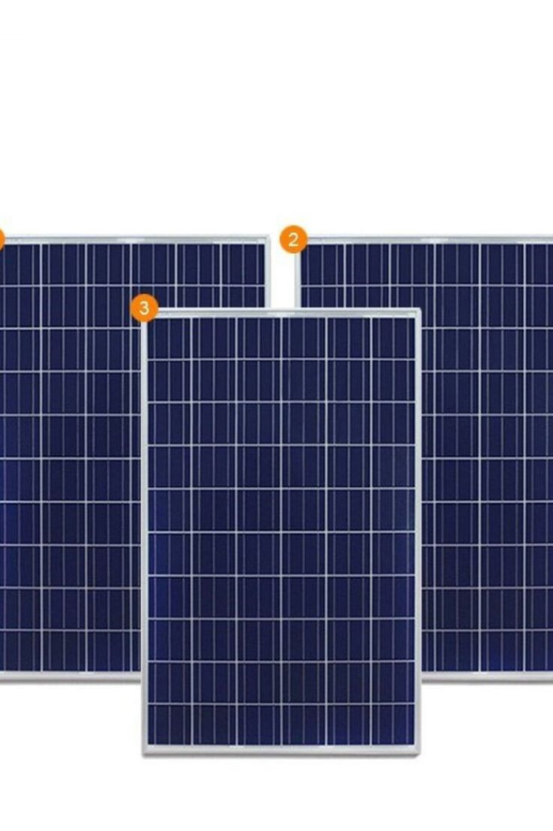
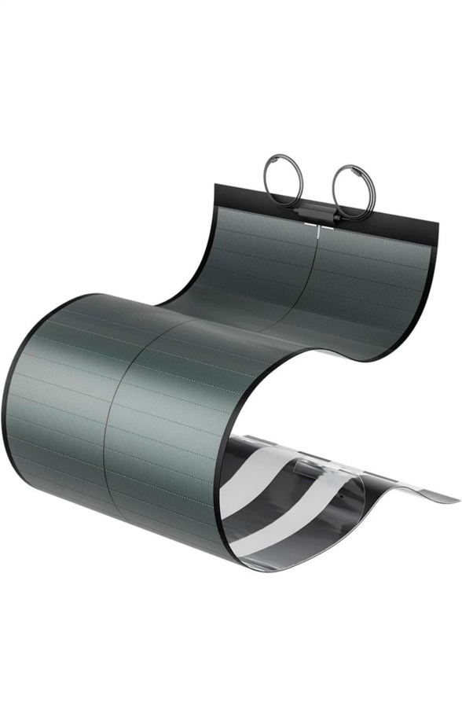
Types of Solar Panels
1. Monocrystalline Solar Panels
  Made from a single, pure piece of silicon.
  Most efficient and long-lasting.
  Usually black in color.
2. Polycrystalline Solar Panels
  Made from many silicon fragments melted together.
  Less efficient than monocrystalline but more affordable.
  Usually blue in color.
3. Thin-Film Solar Panels
  Made by layering thin materials like amorphous silicon or other compounds.
  Lightweight, flexible, and easy to install.
  Lower efficiency but good for large areas or portable use.

Slide 7
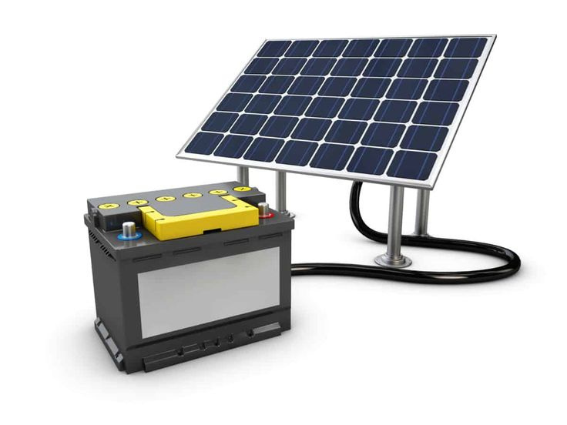
Batteries in Solar Systems
Batteries in solar systems store the extra electricity produced by solar panels so it can be used later, especially at night or during cloudy weather. They help keep a steady power supply even when the Sun isn’t shining. Common types include lead-acid and lithium-ion batteries, with lithium-ion being more efficient and longer lasting. These batteries make solar systems more reliable by ensuring that the energy collected during the day is available whenever it’s needed.

Slide 8
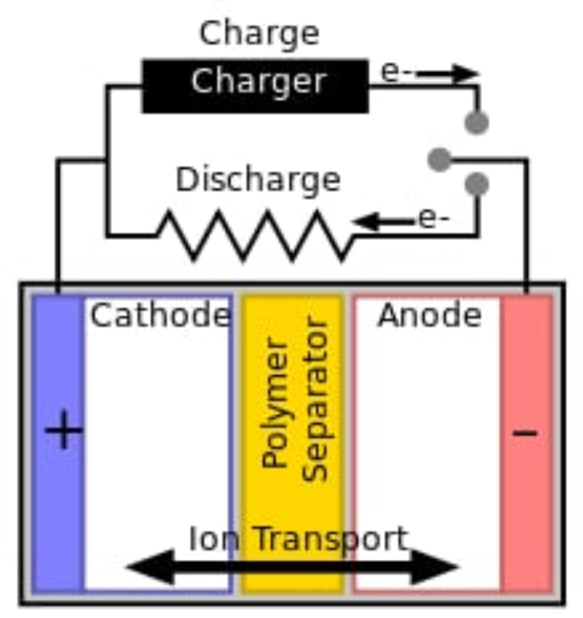
How Batteries Store Power
Batteries store power by keeping energy in the form of chemical reactions. When a battery charges, electricity from the solar panels changes the chemicals inside the battery into a “charged” state. When power is needed, the battery releases this stored energy by reversing the chemical reaction, which produces an electric current. This flow of electricity can then be used to run lights, appliances, or other devices.

Slide 9
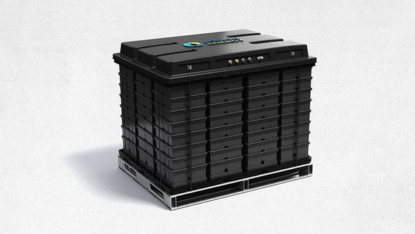
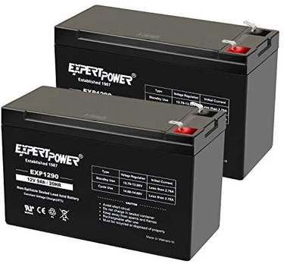
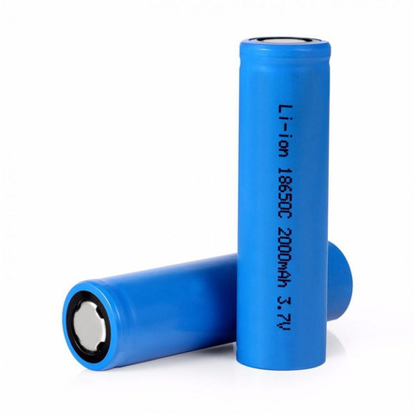
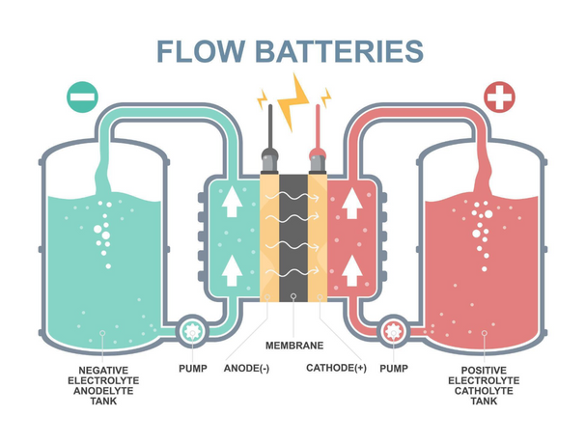
3. Saltwater Batteries
  Use saltwater as the electrolyte.
  Environmentally friendly and safe.
  Lower energy density, so larger size is needed for the same power.
Types of Solar Batteries
1. Lead-Acid Batteries
  Traditional and widely used.
  Affordable but heavier and have a shorter lifespan.
  Good for small or backup solar systems.
4. Flow Batteries
  Store energy in liquid electrolytes in tanks.
  Can be scaled up for large solar installations.
  Long lifespan but more expensive and complex.
2. Lithium-Ion Batteries
  Lightweight, efficient, and long-lasting.
  Can store more energy in a smaller space.
  Ideal for modern solar homes and off-grid systems.

Slide 10
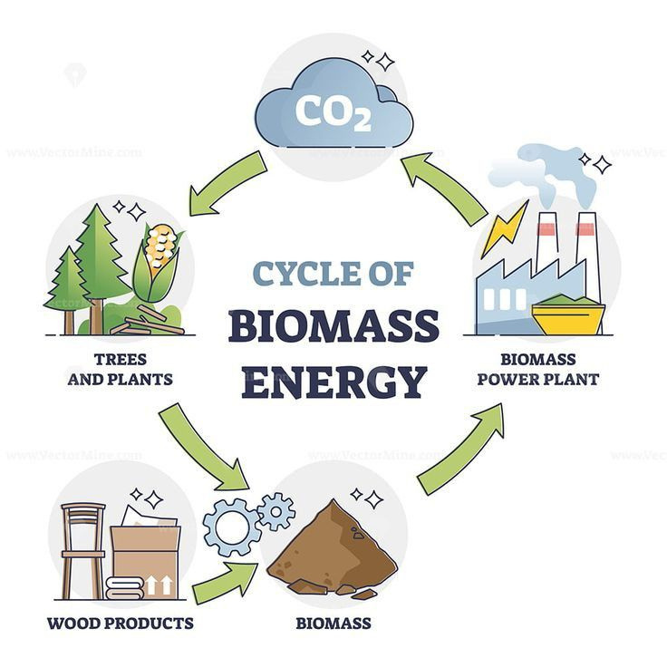
Biomass Energy
Biomass energy is energy produced from organic materials like plants, wood, crop waste, and animal dung. These materials store energy from the Sun through photosynthesis. When burned or converted into biofuels, this stored energy is released as heat or electricity. Biomass is a renewable energy source because plants and organic waste can be regrown or replenished, and it can help reduce waste while providing a sustainable source of power.

Slide 11
How Biomass Produces Energy
Biomass produces energy by releasing the chemical energy stored in organic materials. When plants, wood, or waste are burned, they release heat that can be used for cooking, heating, or generating electricity. Biomass can also be converted into biofuels like biogas or biodiesel, which can power engines or turbines. In all cases, the energy originally came from the Sun, stored in the plant’s growth through photosynthesis.

Slide 12
Advantages
🌞 Solar Cells
  Renewable and abundant source of energy.
  Produces clean energy with no pollution.
  Low operating costs after installation.
  Can power homes, devices, and remote areas.
🌱 Biomass
  Renewable energy source from plants and waste.
  Helps reduce waste by using organic materials.
  Can produce heat, electricity, or biofuels.
  Supports rural and agricultural energy needs.
🔋 Batteries (in Solar Systems)
  Store energy for use at night or cloudy days.
  Ensure a steady and reliable power supply.
  Can reduce dependence on the grid.
  Some types (like lithium-ion) are long-lasting and efficient.

Slide 13
Summary
Solar cells, batteries, and biomass are all renewable energy sources. Solar cells provide clean, abundant energy from sunlight. Batteries store energy for use when sunlight isn’t available, ensuring a reliable power supply. Biomass uses organic materials to produce heat, electricity, or biofuels while reducing waste and supporting sustainable energy.

Slide 14
QUIZ TIME
Renewable Energy Quiz
1. What is solar energy?
a) Energy from water
b) Energy from the Sun
c) Energy from wind
d) Energy from coal
2. What device converts sunlight directly into electricity?
a) Battery
b) Solar cell
c) Turbine
d) Generator
3. Which type of solar panel is made from a single piece of silicon and is very efficient?
a) Polycrystalline
b) Monocrystalline
c) Thin-film
d) Flow
4. Why are batteries used in solar systems?
a) To make solar panels last longer
b) To store energy for use when the Sun isn’t shining
c) To produce sunlight
d) To increase wind speed
5. Which type of battery is lightweight, efficient, and long-lasting?
a) Lead-acid
b) Lithium-ion
c) Saltwater
d) Flow

Slide 15
QUIZ TIME
6. Biomass energy comes from:
a) Fossil fuels
b) Organic materials like plants and waste
c) Sunlight directly
d) Wind
7. How does biomass release energy?
a) By spinning turbines
b) By chemical reactions when burned or converted to biofuel
c) By reflecting sunlight
d) By moving water
8. One advantage of solar cells is that they:
a) Produce pollution
b) Are renewable and clean
c) Only work at night
d) Are very heavy
9. An example of solar thermal energy is:
a) Solar panels producing electricity
b) Solar water heaters
c) Batteries storing energy
d) Wind turbines
10. Why is biomass considered renewable?
a) It comes from fossil fuels
b) Plants and waste can be regrown or replenished
c) It uses sunlight directly
d) It never runs out in the Sun

Slide 16
REFERENCE
Solar Energy Basics
National Renewable Energy Laboratory (NREL). Solar Energy Basics. https://www.nrel.gov/research/re-solar.html
U.S. Department of Energy. How Solar Panels Work.
https://www.energy.gov/eere/solar/how-solar-panels-work
Types of Solar Panels
EnergySage. Monocrystalline vs Polycrystalline vs Thin-Film Solar Panels. https://www.energysage.com/solar/101/solar-panel-types/
Solar Batteries
Clean Energy Reviews. Best Solar Batteries. https://www.cleanenergyreviews.info/solar-battery-reviews

Slide 17


THANK YOU

